Slide 1

Notes to Instructor
Material Needed
Hard copies of the SDTM IG V3.2 printed out and bound for each participant
Post-it Note Flags (rectangular and colored on one end) – each participant will need about 2-3 packs of these (~50 or so flags per person)
Each participant will need to bring their laptop to access workshop templates needed to complete workshop exercises
Excel file Exercise Templates and additional electronic resources (can be e-mailed ahead of time)

Slide 2
Electronic Documents Required
Lilly Stats Workshop Mod2.pptx (this power point)
Participants will need the following for exercises:
Stats Mod 2 Exercise.xlsx
For Reference (also on SharePoint):
Core_ADAM_ADAE_V6-1.xlsx
Core_ADAM_ADSL_V5-2.xlsx
Core_SDTM_AE_V3-1.xlsx
Core_SDTM_DM_V1.-1xlsx
Core_CRF_AE3001_V2.pdf
Core_CRF_AE4001_V2.pdf
Core_CRF_AE5001_V1.pdf

Slide 3
Stat Workshop Module 2 Understanding the Linkage between SDTM and ADaM

Slide 4
Objectives
Encourage participation to enhance learning in this hands-on workshop
Present a high level overview of SDTM domain classes
Introduce what and how certain SDTM variables can be mapped into ADaM data sets
Participants will determine ADaM metadata based on relevant SDTM metadata
Participants will use traceability to map data points from a specific Table to ADaM to SDTM to CRFs

Slide 5
FDA Resources

Slide 6
FDA Standards Timeline
Common Issues Document
Created help guide to address common issues with SDTM submissions
FINAL Guidance Approved!
Guidance allows FDA to require data standards
SDTM Reference
SDTM recommended for regulatory submissions – first study data specs
2004
2009
2010
2012
2014
2016
Computational Science Center
Created new office at FDA to support tools and standards
Study Data Specs V2.0
Rewrite referencing SDTM, ADaM and Define.xml
MUST COMPLY
Companies must comply by Dec. 2016!
Guidance is FINAL
http://www.fda.gov/

Slide 7

FDA and PDUFA V
The Prescription Drug User Fee Act (PDUFA) was enacted in 1992 and renewed in 1997 (PDUFA II), 2002 (PDUFA III), 2007 (PDUFA IV), and 2012 (PDUFA V)
It authorizes FDA to collect fees from companies that produce certain human drug and biological products
PDUFA V: Fiscal Years 2013 – 2017: Requires Electronic Submissions and Standardization of Electronic Application Data
Guidance document finalized December 2014 – Companies have 2 years to comply

Slide 8
FDA Documents – Dec 17, 2014*
Providing Regulatory Submissions In Electronic Format – Standardized Study Data*
The FINAL word on FDA Submissions must be “electronic” and must use “CDISC Standards”
Data Standards Catalog (Ongoing Updates)
Gives list of Standards the FDA will accept and dates they will accept them
Study Data Technical Conformance Guide* (Technical Specifications Document)
Non-binding reference

Slide 9
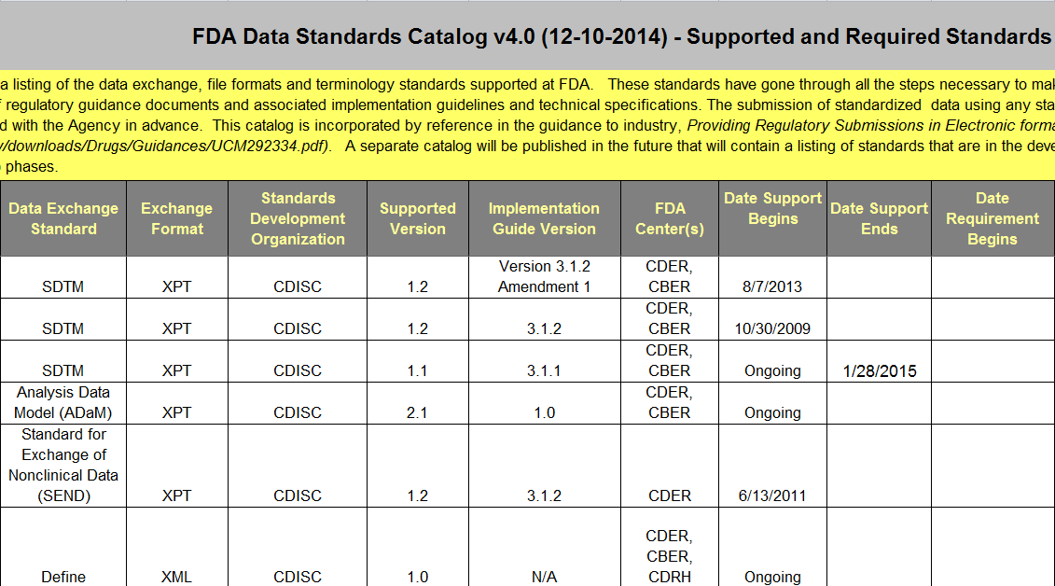
Standards Catalog Screen Shot

Slide 10
CDISC SDTM Overview

Slide 11
SDTM Basics: Domains & Classes
Domains:
Observations about study subjects are collected in a series of domains
Domains are a collection of logically related observations
Single dataset and two- character code (e.g., AE)
Observation Classes:
Categories of domains
Most domains are part of three main classes: Events, Interventions, or Findings
Class
(e.g., Events)
Domain (e.g., AE)
Domain (e.g., DS)
Domain (e.g., MH)

Slide 12

Class: Special Purpose
Special purpose domains are domains that do not conform to one of the three general observation classes (Interventions, Events, Findings)
CO
Demographics
Subject Elements
Subject Visits
SE
SV
Comments
DM

Slide 13
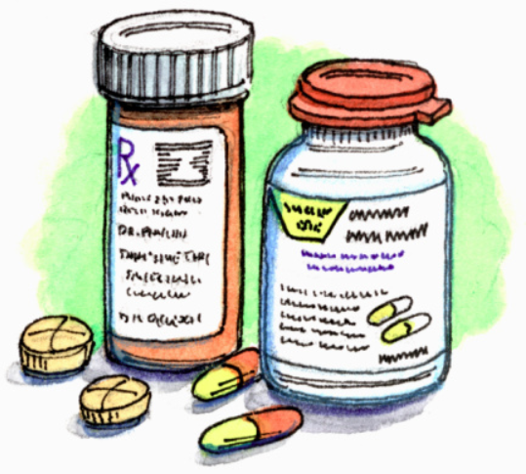
Class: Interventions
Intervention domains capture investigational, therapeutic, and other treatments administered to patient
Think…“Did something happen to your body”?
CM
Exposure
Exposure as Collected
Procedure
EC
PR
Concomitant and Prior Medications
EX
SU
Substance Use

Slide 14


Class: Events
Captures planned protocol milestones such as randomization, study completion, occurrences, or incidents independent of study evaluations or prior to trial
AE
Clinical Events
Disposition
Protocol Deviations
DS
DV
Adverse Events
CE
HO
Healthcare Encounters
MH
Medical History

Slide 15

Class: Findings
Captures the observations resulting from planned evaluations to address specific tests or questions such as labs, ECG, and questions on a questionnaire
DA
Death Details
ECG Results
EG
Drug Accountability
DD
All Findings
21 Findings Domains TOTAL
…
…

Slide 16

Class: Findings About
Intended to be used when collected data represents “findings about” and Event or Intervention that cannot be represented within an Event or Intervention
FA
Findings About
SR
Skin Response

Slide 17
Three Main Types of Classes
Results of Tests: Think Labs, Vital Signs, Questionnaires, etc.
Interventions
xxTESTCD = Short Name of Measurement, Test or Examination
Findings
Events
Treatments: Think Con Meds, Exposure, Procedures, etc.
xxTRT = Name of Treatment
xxTERM = Reported Term for the type of Event/Milestone
Events that may not happen to all subjects or Planned Protocol Milestones: Think Adverse Events, Disposition, etc.

Slide 18
Key SDTM and ADaM Principles

Slide 19
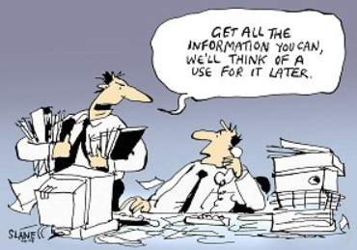
Key Principles of SDTM
SDTM data represents the collected data in the standardized tabulated form
SDTM data can be used in place of listings
Analysis derivations are done in ADaM and not in SDTM! Some derivations are required and allowed in SDTM (e.g., RFSTDTC)

Slide 20
Purpose of ADaM
“The purpose of ADaM is to provide a framework that enables analysis of the data, while at the same time allowing reviewers and other recipients of the data to have a clear understanding of the data’s lineage from collection to analysis to results.” – ADaM V2.1 page 3
CDASH
TFLs
SDTM
ADaM

Slide 21
What is Traceability?
In the perfect study, it should be possible to trace a data point from the analysis results (TFLs) back to the original data
For ADaM data sets, the traceability provides a relationship to link the following: analysis results, analysis data sets (ADaM), SDTM domains, and raw data sets
Raw Data Sets
ADaM Data Sets
Analysis Results
SDTM Domains

Slide 22

Successful Traceability
Reviewers will be able to identify:
Information that exists in the submitted SDTM study tabulation data
Information that is derived or imputed within the ADaM analysis data set
The method used to create derived or imputed data
Information used for analysis vs. information used for traceability
Think mapping data for the FDA →

Slide 23
SDTM Variables in ADaM Data Sets
Many variables from SDTM domains are copied directly into ADaM data sets
All metadata and data MUST BE EXACTLY THE SAME!
Variable Label
Type (char or num)
Length
Codelist
Values
SDTM Variable in SDTM
SDTM Variable in ADaM

Slide 24
Example SDTM Variable in ADaM Data Set
Metadata: SDTM vs. ADaM
Data: SDTM vs. ADaM
MODEL | DATASET | VARIABLE | LABEL | TYPE | LENGTH | CODELIST
SDTM | DM | ETHNIC | Ethnicity | Char | 22 | CL.ETHNIC
ADaM | ADSL | ETHNIC | Ethnicity | Char | 22 | CL.ETHNIC
ADaM | ADSL | AETHNIC | Analysis Ethnicity | Char | 25 | CL.AETHNIC
MODEL | DATASET | USUBJID | ETHNIC | AETHNIC
SDTM | DM | ABC-1001 | Hispanic
ADaM | ADSL | ABC-1001 | Hispanic | Latin American

Slide 25
Example – What Not To Do!
In the example of SDTM.DM RACE → ADaM.ADSL RACE, the value and the metadata MUST remain the same
Examples of what NOT to do!
DM.RACE | ADSL.RACE
DM.RACE has length $10 | ADSL.RACE has length $12
DM.RACE contains the value “MULTIPLE” | ADSL.RACE decodes the value “MULTIPLE” and had the value “WHITE, ASIAN”
DM.RACE is character with CT values for (RACE) such as “BLACK OR AFRICAN AMERICAN,” “ASIAN,” etc. | ADSL.RACE is numeric with values 1, 2, etc.
DM.RACE label is “Race” | ADSL.RACE label is “Analysis Race”

Slide 26
Example – What To Do Instead
If you want to change anything about an SDTM variable and include it in an ADaM data set, you MUST create a different variable name
Examples of what to do instead!
DM.RACE = ADSL.RACE | ADSL.ARACE or ADSL.RACEN
RACE has length $50 | ARACE has length $40
RACE contains the value “MULTIPLE” | ARACE decodes the value “MULTIPLE” and had the value “WHITE, ASIAN”
RACE is character with CT values for (RACE) such as “BLACK OR AFRICAN AMERICAN,” “ASIAN,” etc. | RACEN is numeric with values 1, 2, etc.
RACE label is “Race” | ARACE label is “Analysis Race”

Slide 27

What SDTM Variable Go Into ADaM?
NOT ALL OF THEM!
No need to create an ADaM version of every SDTM variable
Variables to carry over from SDTM to ADaM:
Required ADaM variables (e.g., USUBJID)
Variables used directly for analysis (e.g., RACE)
Variables carried over for traceability that may be used to derive ADaM variables

Slide 28
Example of ADaM Variables Derived From SDTM Variables
PARAM = “Prone Diastolic Blood Pressure (mmHg)”
VSPOS = “PRONE”
VSTEST = “Diastolic Blood Pressure”
VSSTRESU = “mmHg”
RACEN
Numeric value
based on RACE
RACEN | RACE
1 | American Indian or Alaska Native
2 | Asian
3 | Black or African American
4 | Native Hawaiian or Other Islander
5 | White
6 | Multiple

Slide 29
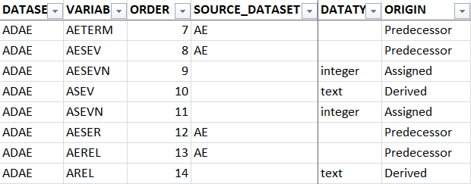
ADaM Spec Writing & Review
Key to Connect SDTM to ADaM
Use metadata to make connection
Metadata defined in one place only (however, in next exercise you will practice learning how it will be programmatically defined)

Slide 30
Stats Module 2 Exercise #1 ADaM Metadata based on SDTM Metadata

Slide 31
Stats Mod 2 Exercise #1
As a Study SME, you determine that you need to create an ADAE data set to produce AE incidence tables and plan to keep the following SDTM.AE and/or ADaM.ADSL
Variables: STUDYID, USUBJID, AESEQ, AEGRPID, AEDECOD, and SAFFL
Determine the ADAE metadata, if applicable, for the variables above:
Metadata: DATATYPE, LABEL, SASLENGTH, VLFLAG, SASTYPE, CTLIST, and DICTIONARY_NAME
Note: This exercise is designed to focus on generating ADaM metadata from SDTM / ADaM metadata and is not tied to a specific AE incidence table

Slide 32
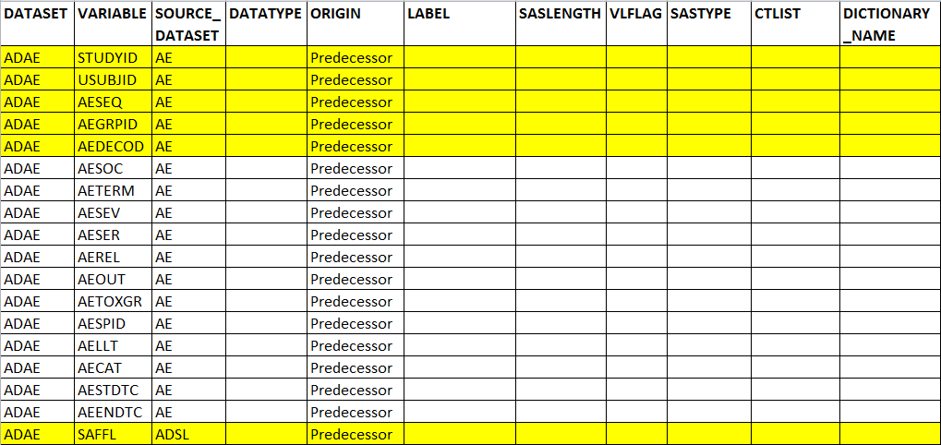
ADAE Study Specification
In other words, complete the yellow highlighted cells in Stats Mod 2 Exercise Template

Slide 33
Resources & Assumptions
Resources:
AE Study Spec: Use Core_SDTM_AE_V3-1.xlsx
ADSL Study Spec: Use Core_ADAM_ADSL_V5-2.xlsx
ADAE Study Spec: Use Core_ADaM_ADAE_V6-1.xlsx
Use Stats Mod 2 Exercise.xlsx tab “Stat Mod 2 Ex. 1” to complete this exercise
Assumptions:
You only need to provide metadata for the variables STUDYID, USUBJID, AESEQ, AEGRPID, AEDECOD, and SAFFL
The other variables and metadata are there to make it look and feel like an ADAE Study Specification (Bonus Points if you fill out all of the metadata)
Go Back

Slide 34
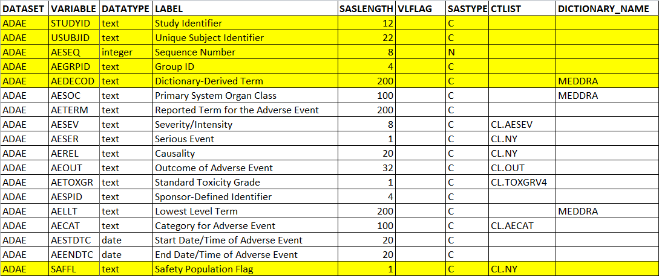
Answer

Slide 35
CRFs and TFLs

Slide 36
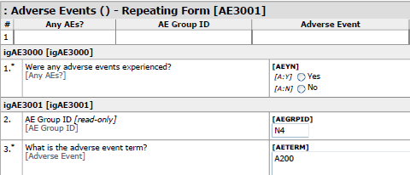
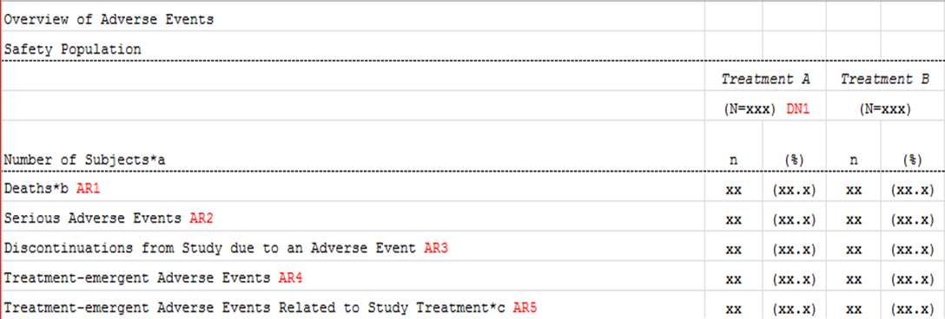
Collection (CRF) to Analysis (TFL)
CRF – Sample
Table – Sample

Slide 37
Stats Module 2 Exercise #2 Traceability: Demographics Table to CRF

Slide 38
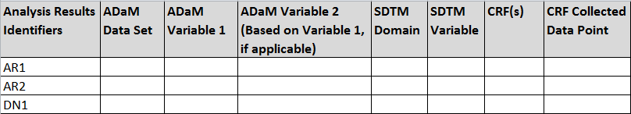
Stats Mod 2 Exercise #2
Given Core_TFL_AE_Overview_V1-1.xlsx
Trace the “Analysis Results Identifiers” on the mock table shell back, and listed below, to:
ADaM data sets & variables
Then ADaM back to SDTM data sets & variables
Then SDTM back to CRF and CRF collected data points

Slide 39
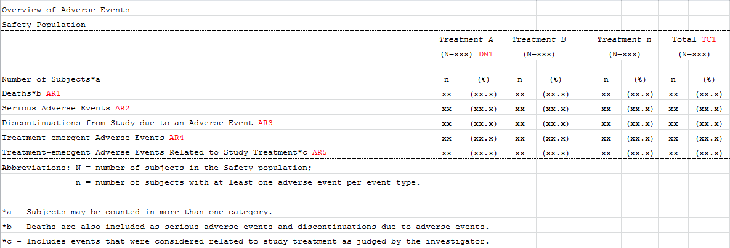
Table: Overview of Adverse Events
Mock Table Shell
Analysis Results Identifiers

Slide 40
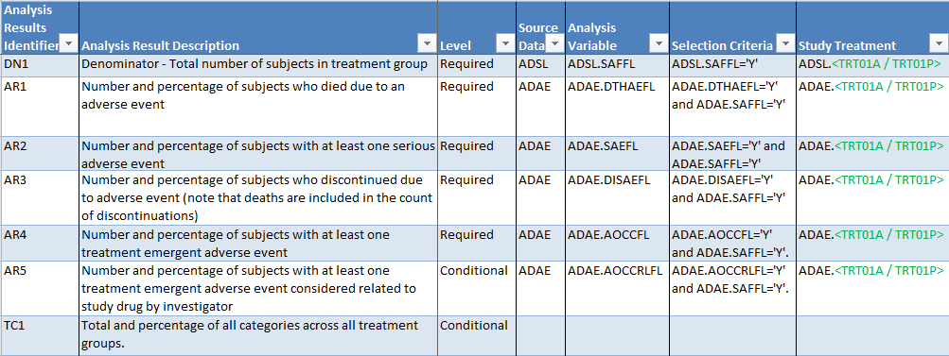
Metadata for Table

Slide 41
Resources & Assumptions
Resources: Excel ADaM Standards, Excel SDTM Standards, and CRFs are provided for you (Note: these can also be found in the Document Library)
For this exercise, assume “Safety Population” is defined as patient received study drug (i.e., Treatment A, Treatment B etc.)
For this exercise, assume the Safety Population analysis is done on the “actual treatment” a subject received as opposed to the randomized treatment

Slide 42
Let’s Do the First One Together
AR1 = Deaths
Open Analysis Results Metadata to find ADaM data set and ADaM Variable
Open ADAE Standard to find ADAE.DTHAEFL
Analysis Results Identifier | Source Data | Analysis Variable
AR1 | ADAE | ADAE.DTHAEFL
DATASET | VARIABLE | ANALYSIS_ALGORITHM
ADAE | DTHAEFL | …set DTHAEFL='Y' for the first record where ADAE.AEOUT="FATAL"
ADAE | AEOUT | Copied from SDTM.AE.AEOUT

Slide 43
First One Continued…
Open AE Standard to find AE.AEOUT
Open CRF: AE3001, AE4001, AE5001 to find raw CRF variable
DATASET | VARIABLE | BUSINESS_ALGORITHM
AE | AEOUT | Set to AE3001, AE4001, or AE5001.AEOUT
#
16.12* | What was the outcome of this adverse event [outcome] | AEOUT [clOUT]
Go Back

Slide 44
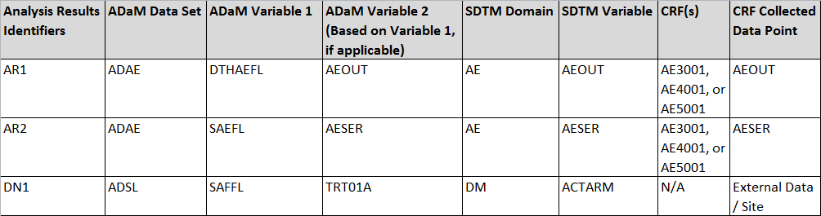
Answer
Notes:
Change ADaM Variable 2 on 3rd record from TRT01A to ACTARM

Slide 45
Summary
FDA regulations require electronic standard submissions within 2 years of Dec. 17, 2014
SDTM data sets are defined by Classes and Domains
If an SDTM variable is carried over into an ADaM data set, the values of the variable and all of the metadata associated with that variable MUST remain the same
“Traceability” and metadata allow reviewers to easily understand how analysis results are derived from ADaM variables, how ADaM variables are derived from SDTM & ADaM variables, and how SDTM variables are derived from raw CRF data

Slide 46
End of Stat Module 2 ☺

